Slide 1
Analyzing Amazon Sales data

Slide 2
Agenda
Project Details
Objectives
Problem Statement
Process Flow
Insights
Sales overview on World map
Designed Visuals
Conclusion

Slide 3
Project Details
Technology | Business Intelligence
Domain | E-commerce
Project Level | Advanced
Programming Language Used | Python, R Scripting
Tools/ Libraries used | Kaggle, MS-Excel, PowerBI, NumPy, Pandas, Matplotlib, Seaborn.

Slide 4
Objectives
Perform ETL on Amazon's sales dataset.
Analyze sales trends on a monthly, yearly, and yearly-monthly basis.
Identify key metrics and factors that significantly impact sales.
Discover meaningful relationships between different attributes in the dataset.
Provide actionable insights to optimize sales management strategies.

Slide 5

Problem Statement
In today's competitive commercial environment, efficient sales management is crucial for the success of companies like Amazon. Constant optimization of sales techniques is necessary for cost reduction and profit maximization.
However, the vast amount of daily sales data makes it challenging to understand sales patterns and identify key metrics. This project aims to analyze Amazon's sales data to uncover month-by-month, year-by-year, and yearly-by-month sales trends.

Slide 6
Process flow
Data Exploration & Analysis
Analyzing the data visuals on Power Bi
Design Visualizations
Presenting the final conclusions
Data Collection
Data Cleaning & Preparation

Slide 7
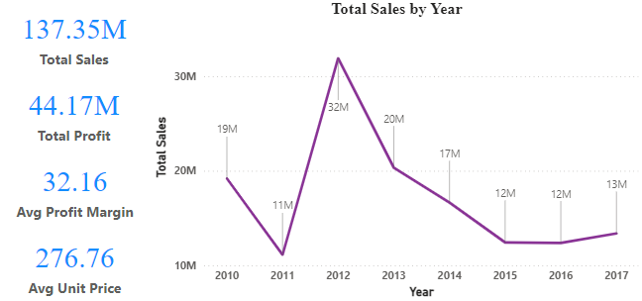
Insights
The company is experiencing steady growth in both sales and profit. Total sales have grown from $13 million in 2010 to $137.35 million in 2017. Profit has also grown steadily, from $11 million in 2010 to $32.16 million in 2017.
The average unit price has remained relatively flat over the same period. This suggests that the company is selling more units of its product, but is not raising prices. This could be due to a number of factors, such as increased competition or a desire to maintain market share.

Slide 8
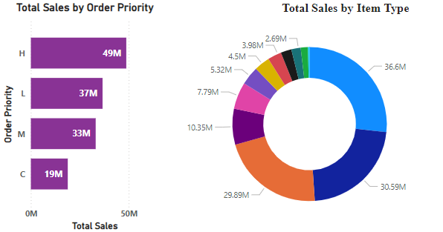
Insights
The pie chart shows the following slices:
Clothing accounts for 36.6 million dollars of total sales.
Electronics accounts for 30.59 million dollars of total sales.
Furniture accounts for 10.35 million dollars of total sales.
Other items account for 29.89 million dollars of total sales.

Slide 9
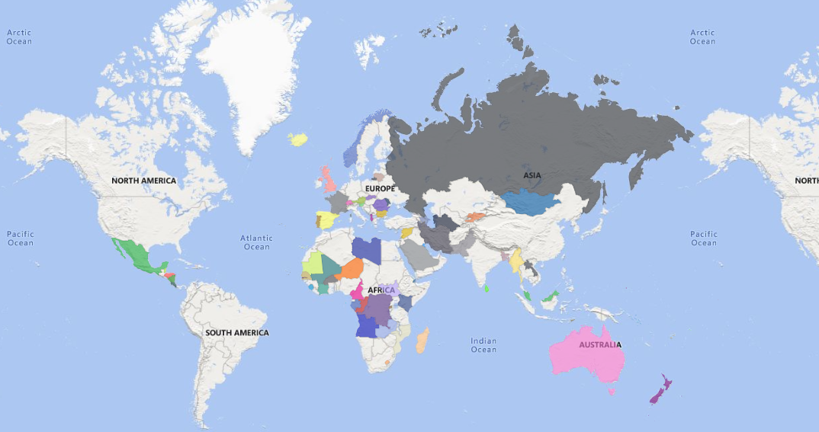
Sales overview on World map
The world map shown depicts the sales per country and revenue generated from that country.

Slide 10
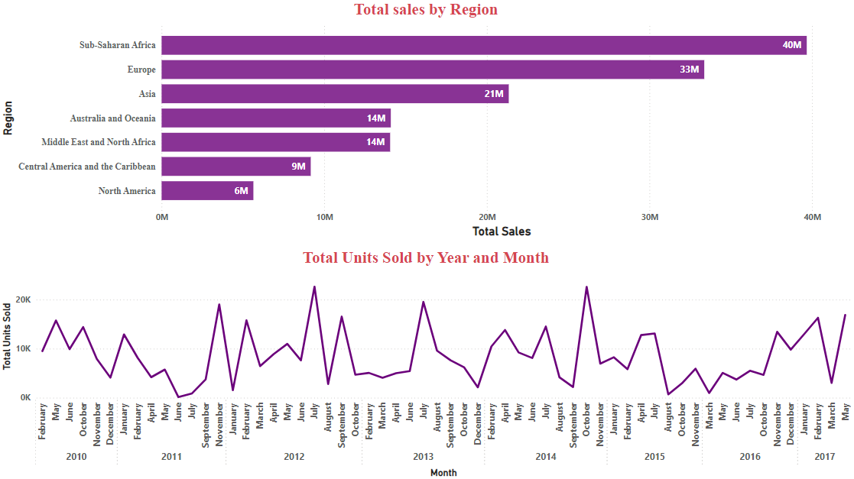
Designed visuals

Slide 11
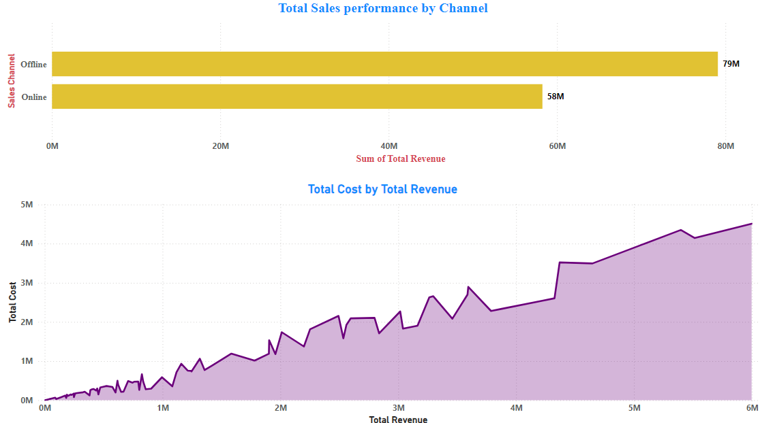
Designed visuals

Slide 12
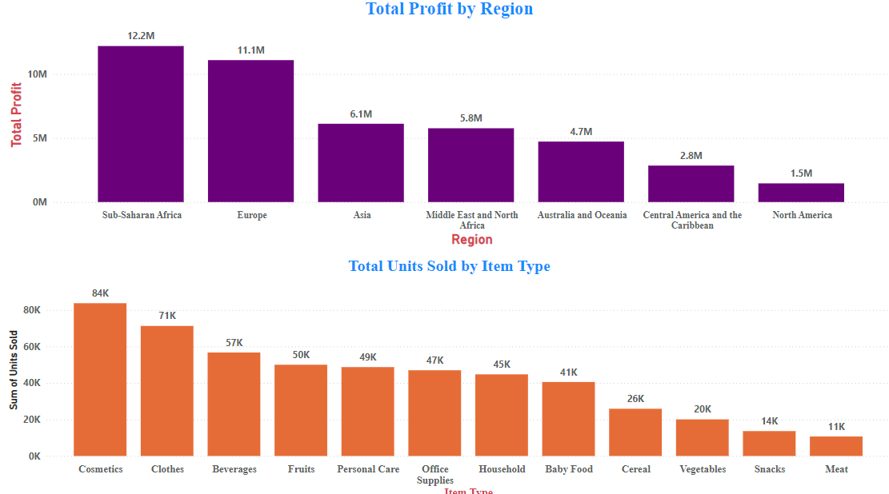
Designed visuals

Slide 13
Conclusions
Cosmetic products are very popular among people of Europe and these products generated the highest profit ($14.56 million) of all items. So, it is advisable to create some marketing campaigns promoting Cosmetic products.
Total Population of North America prefer to shop offline as compared to people of Europe, who mostly prefer Online channel for shopping. But because high profits are coming from Online channel, it advisable to promote products online.
The Region Sub-Saharan Africa has generated the highest profit where people bought Fruits the most, with approx. 31 thousands unit sold. Highlight the health benefits of fruits during campaigns and align marketing with local preferences.
The second most purchased item, after Cosmetics in Europe is Baby Food. This insight tells us that majority of people of Europe are newlywed couples. Thus you can promote products related to new born babies to these people.

Slide 14
Conclusions
Fruits has generated the least profit of all item types which is only $120.50 thousands. It is advisable to understand the customer needs, adjust the price and analyse the local preference.
North America Region has generated the least profit by selling only Personal Care and Household Items through Offline Channel. Try to promote products other than both these item types through Online Channel by giving some discounts. Do some survey to find local people’s preferences.
Meat is the least sold item type with 11 thousands units sold in Australia and Oceania and Sub-Saharan Africa Region using only Online Channel. Consider selling different kinds of meat products and adjust the prices.
Household Items and Cosmetic Products are sold the most through Offline and Online Channels respectively. Enhance physical stores with attractive displays and promotions for Household Items. Run targeted ads and make the website more user friendly for Cosmetic products.

Slide 15
Thank you
Zeeshan Khan
zk2938560@gmail.com
https://www.linkedin.com/in/zeeshan-khan-72110/
© All images in this presentation have been generated or imagined with the help of AI

